Slide 1
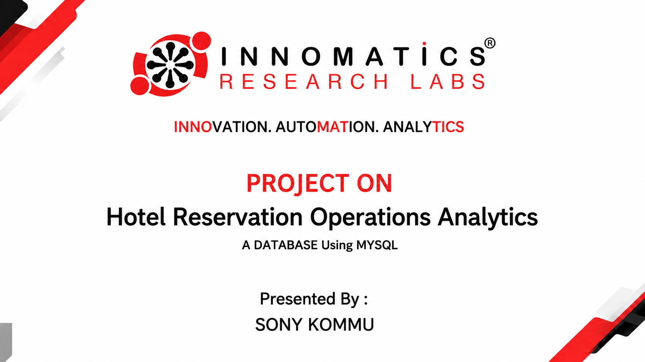

Slide 2
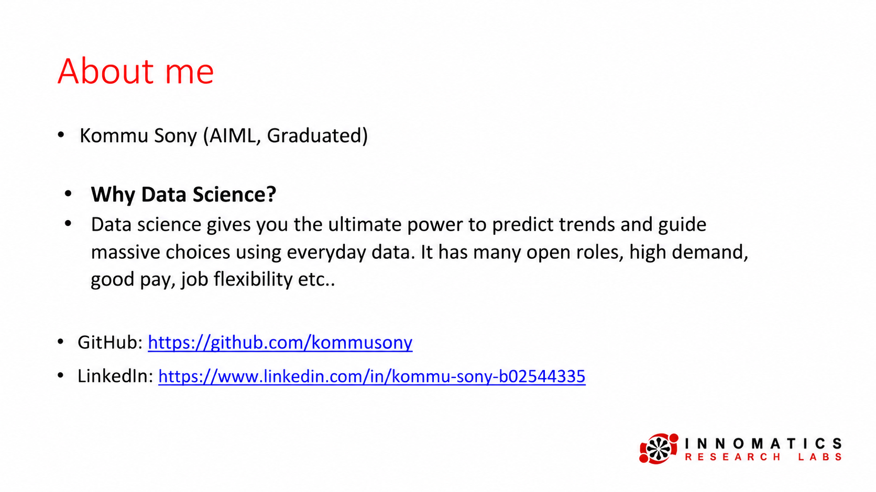

Slide 3

Objective of the Project
• To develop a hotel database using SQL.
• To store guest and hotel details properly.
• To manage room details and availability.
• To maintain booking and stay records.
• To manage staff and their work details.
• To analyze hotel data using SQL queries.
• To get useful results for better hotel management.

Slide 4
Database Structure:
This project contains 6 connected tables:
• Guests
• Hotels
• Staff
• Rooms
• Bookings
• Stays
These tables are connected using Primary Keys and Foreign Keys. This helps to organize the data and maintain proper relationships between different hotel records.

Slide 5
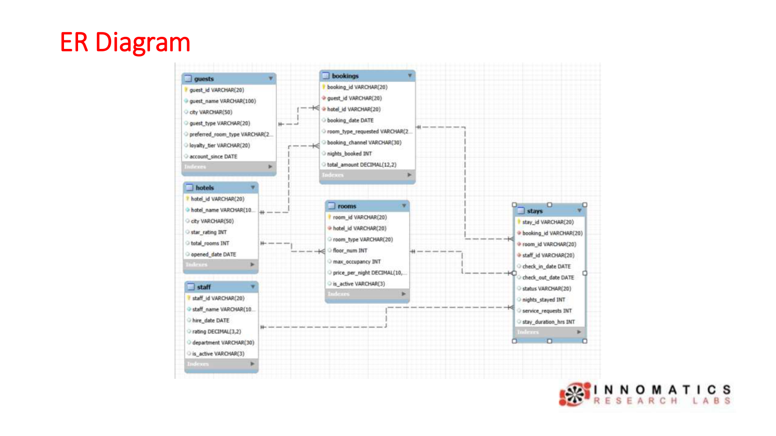

Slide 6
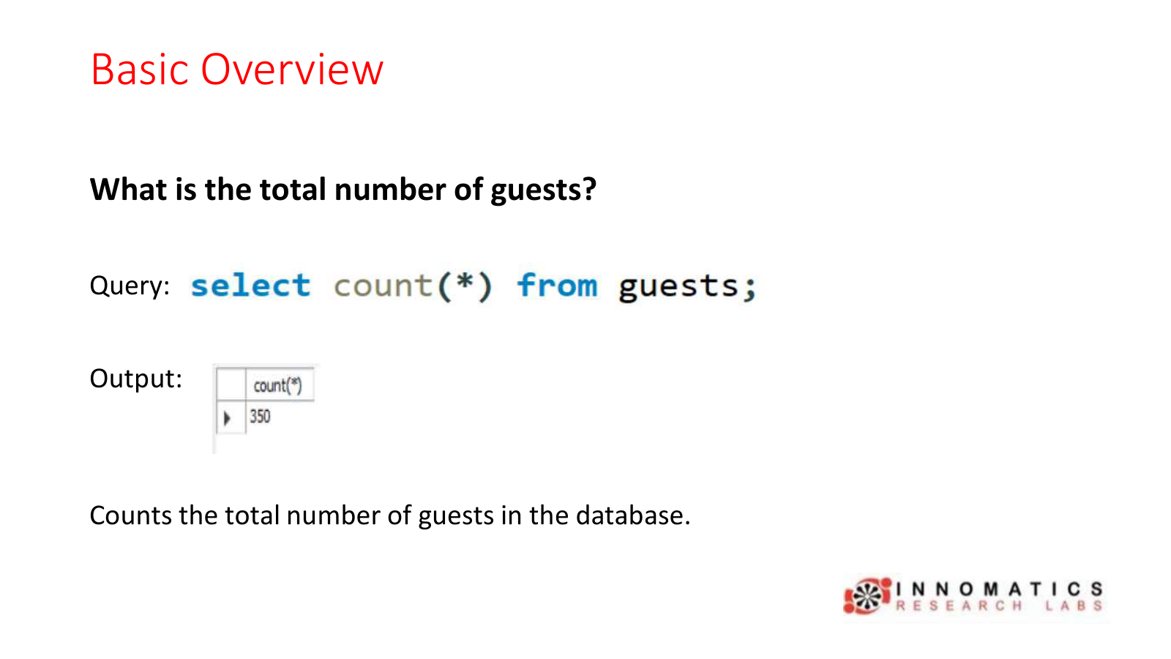

Slide 7
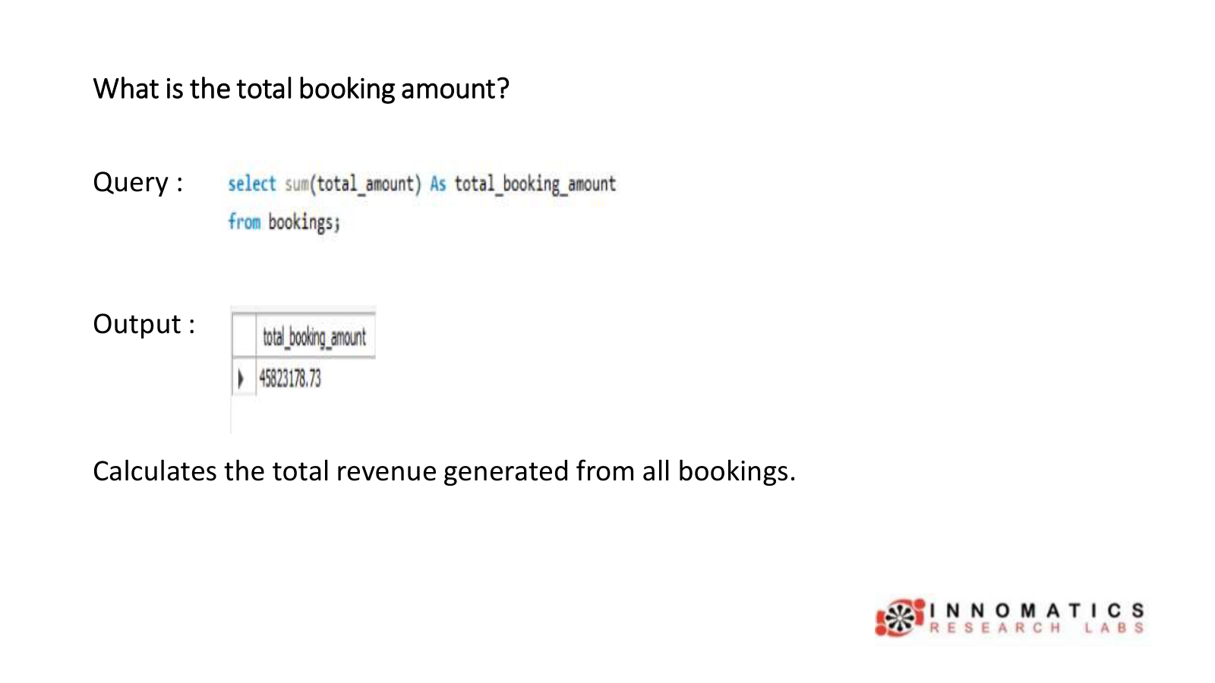

Slide 8
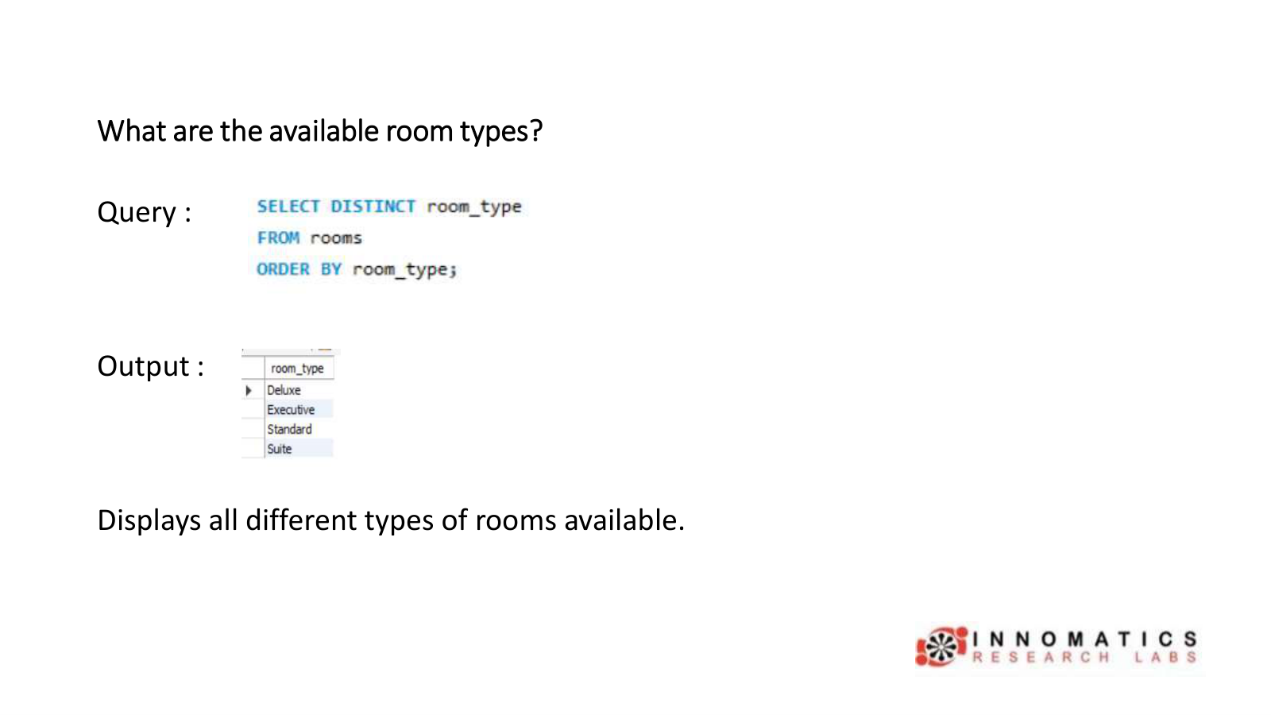

Slide 9
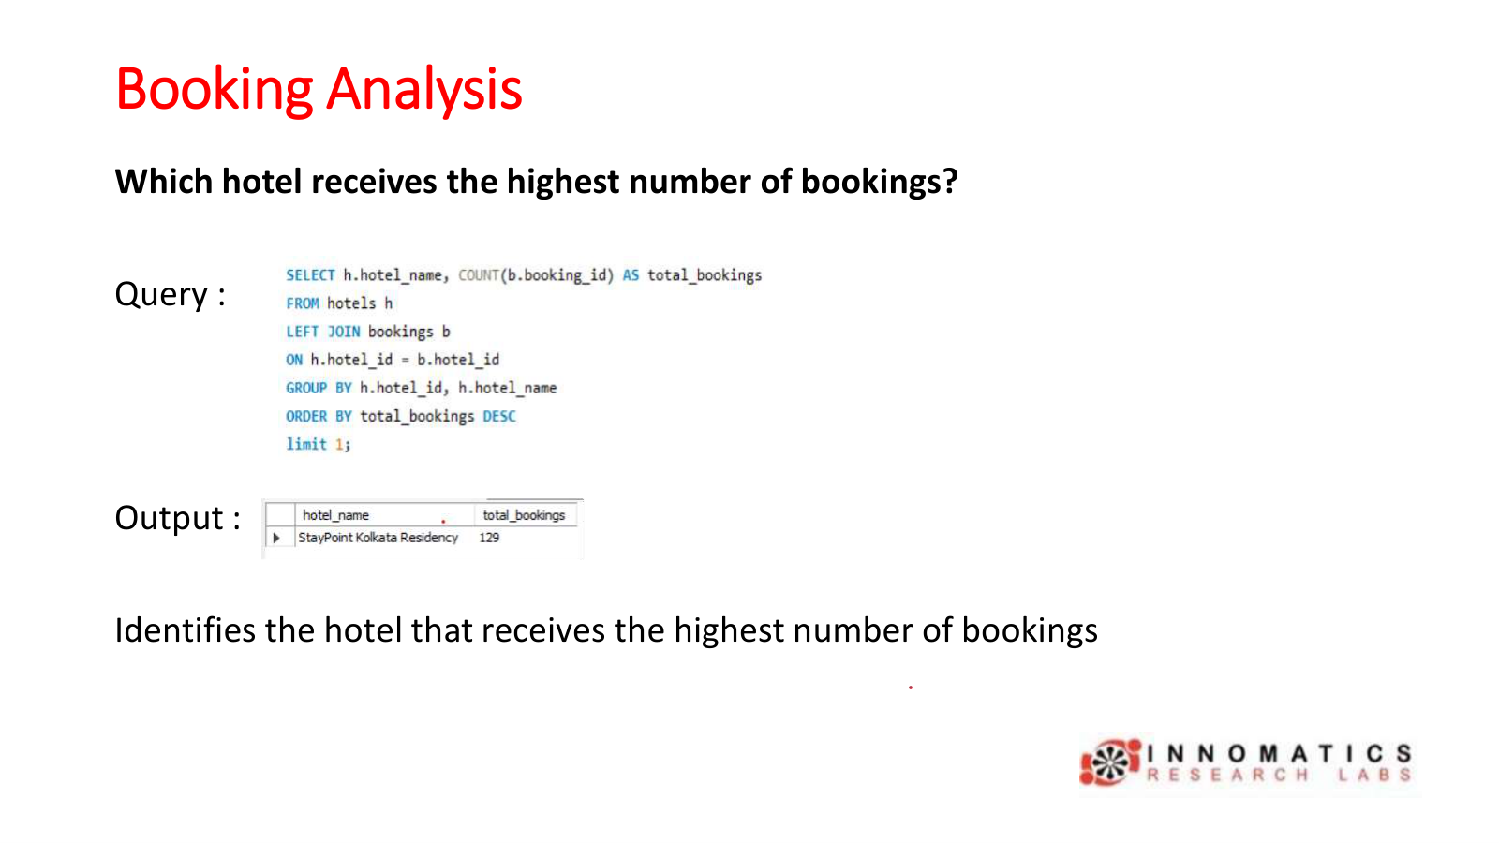

Slide 10
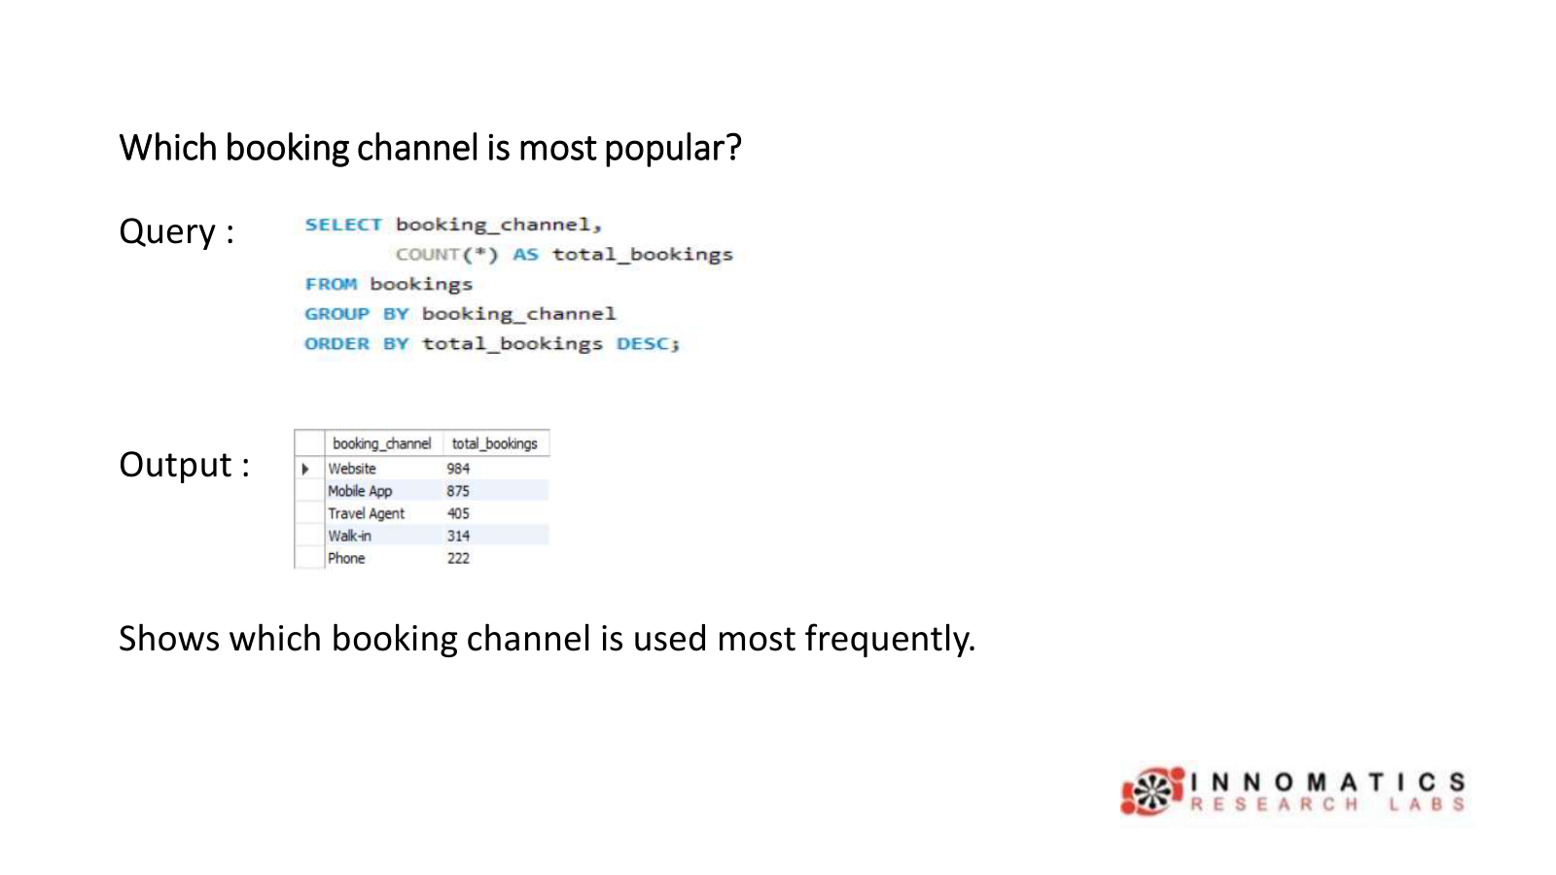

Slide 11
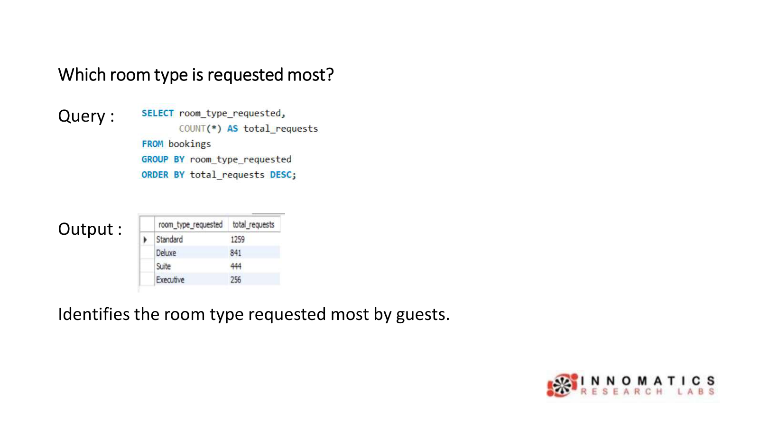

Slide 12
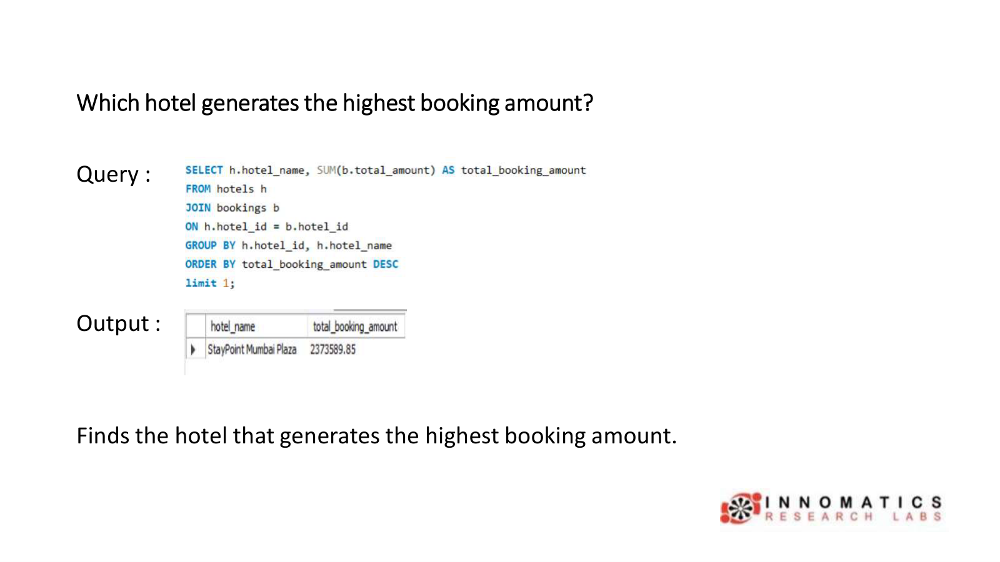

Slide 13
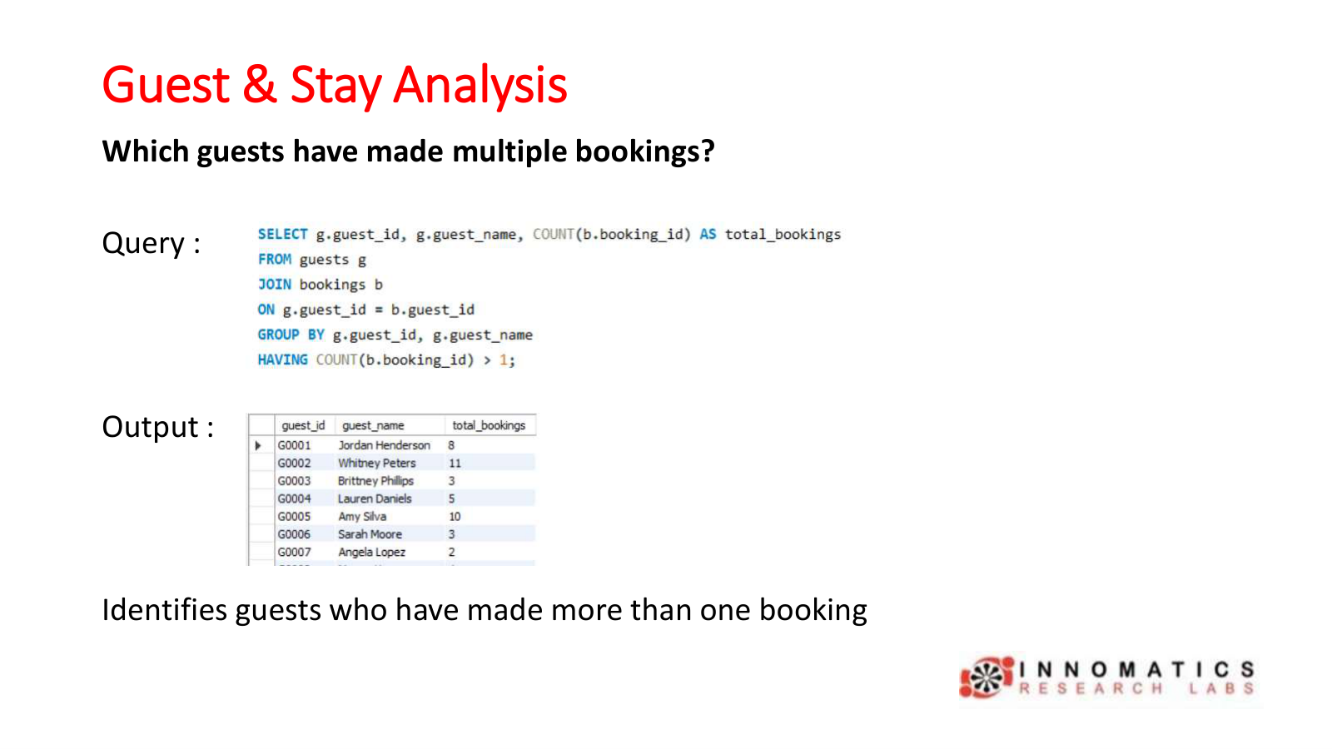

Slide 14
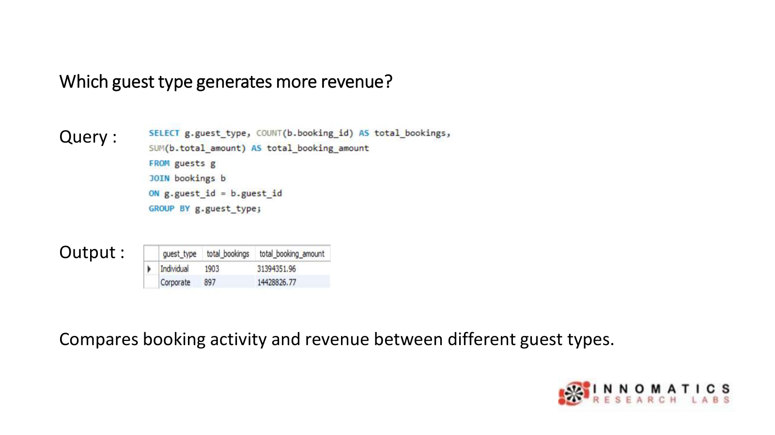

Slide 15
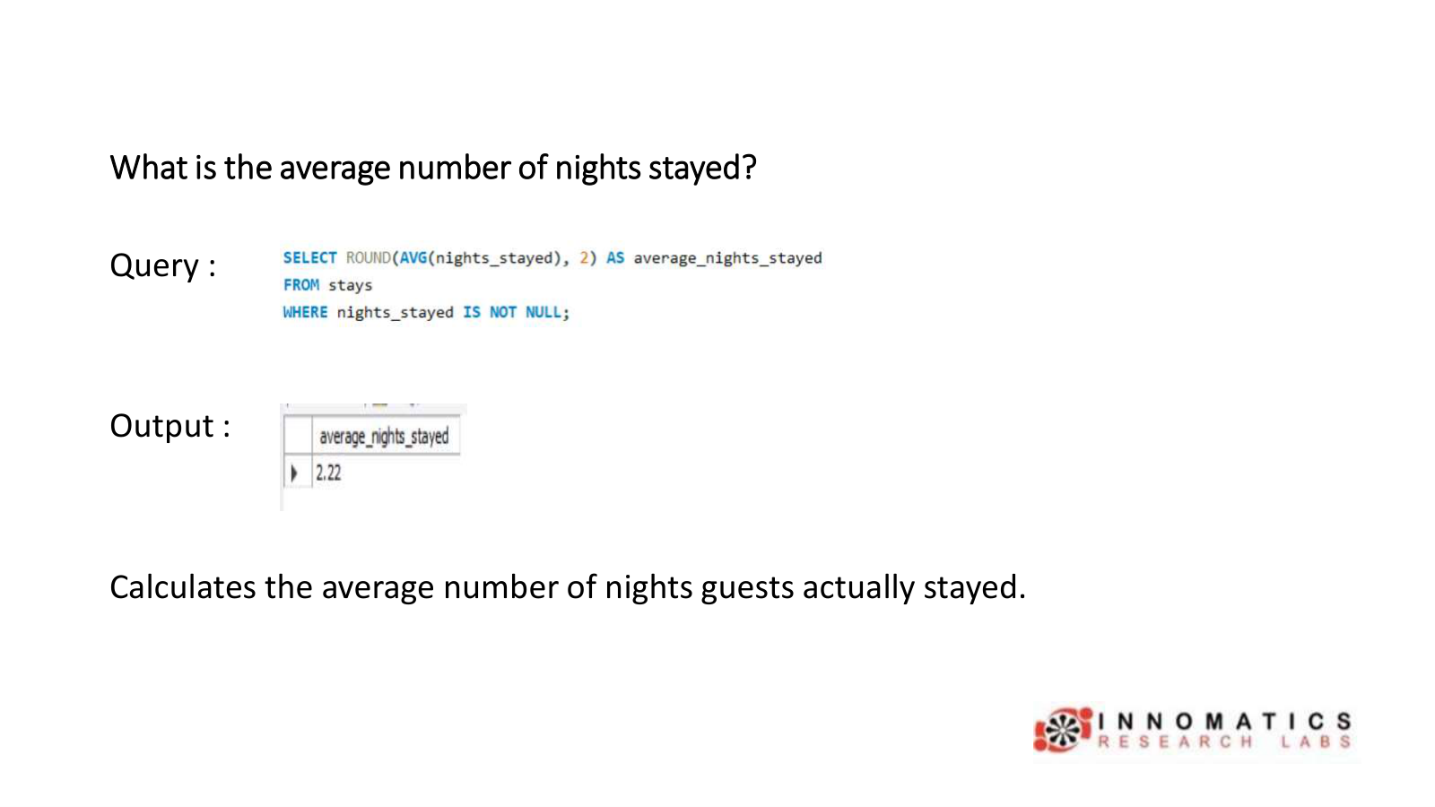

Slide 16
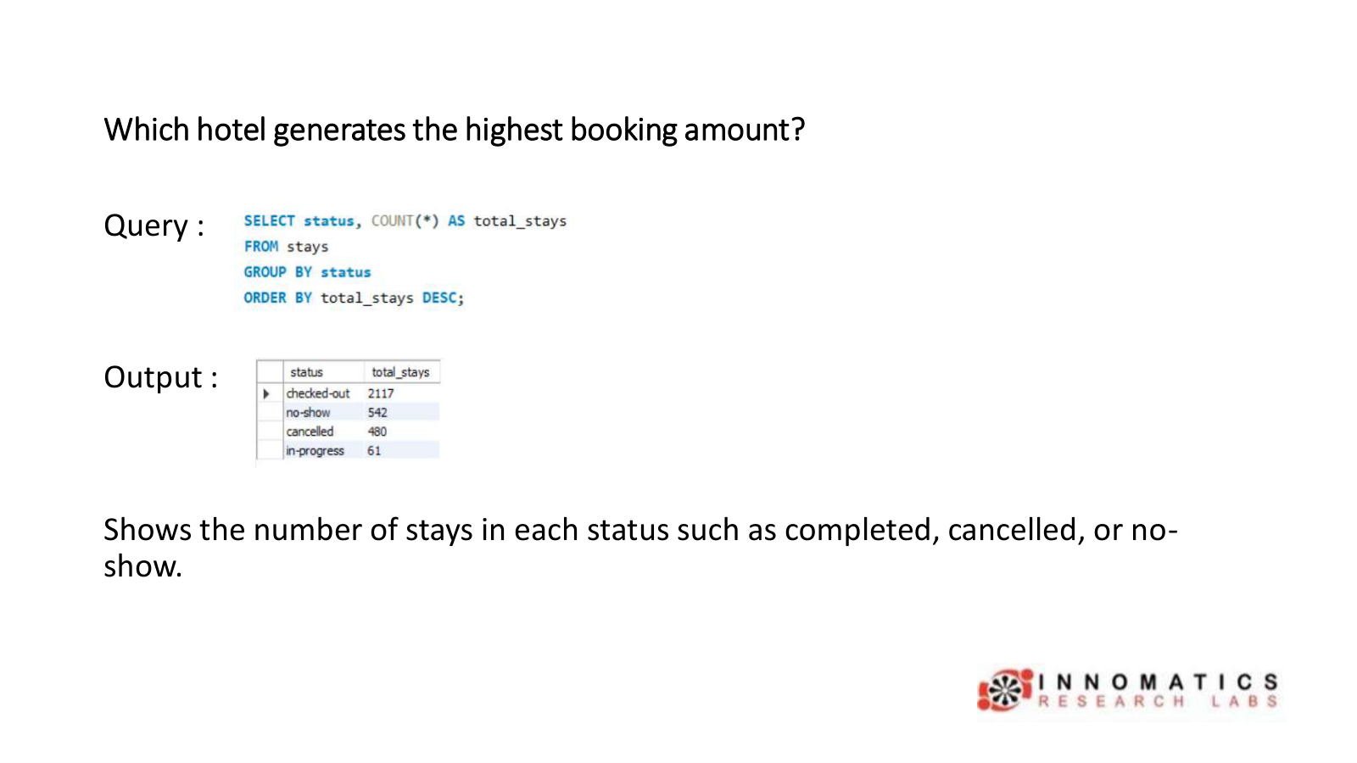

Slide 17
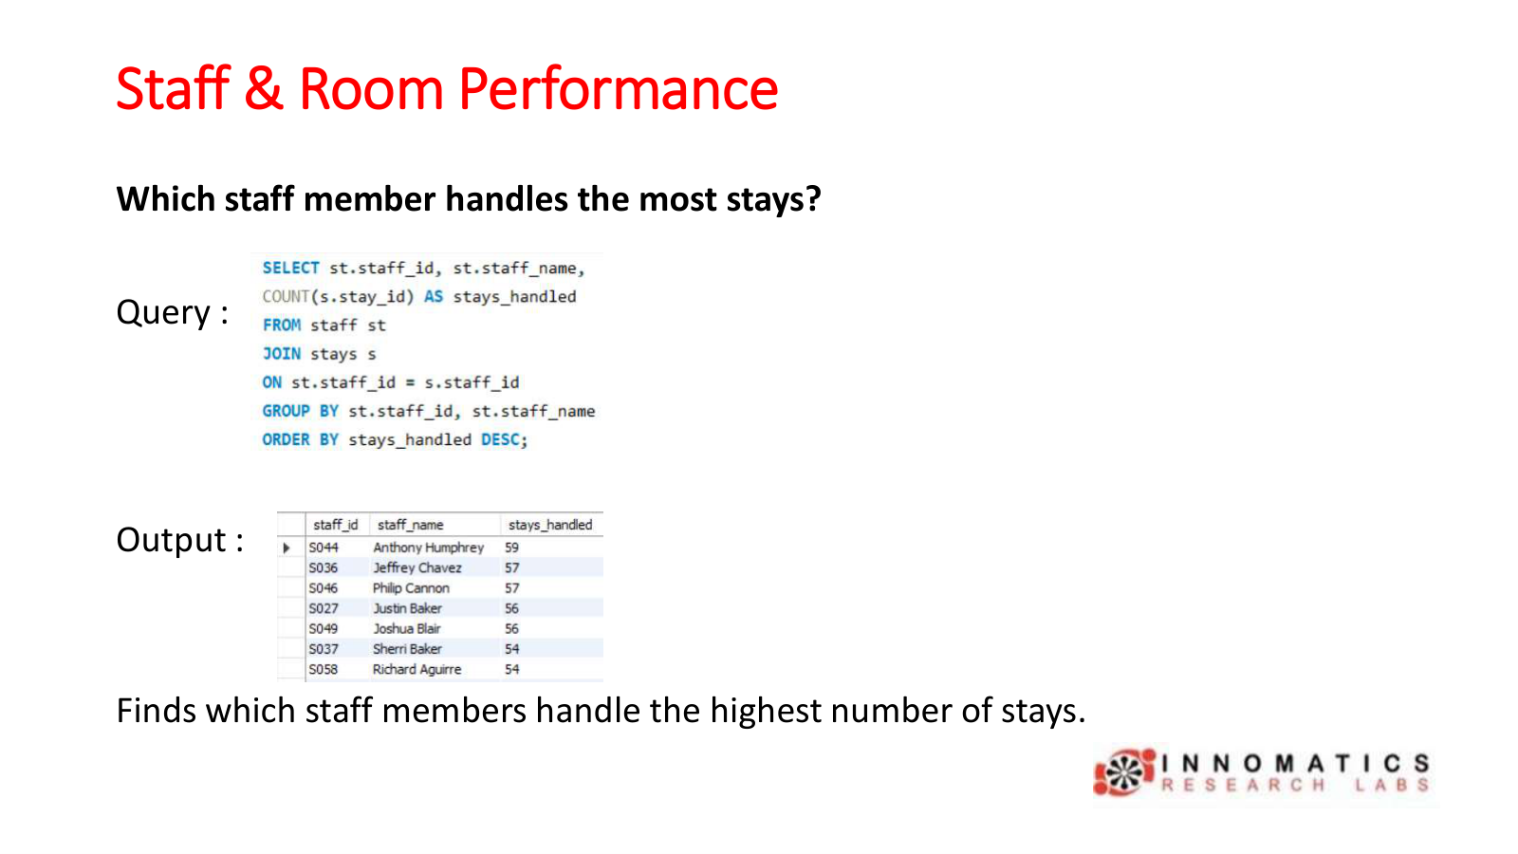

Slide 18
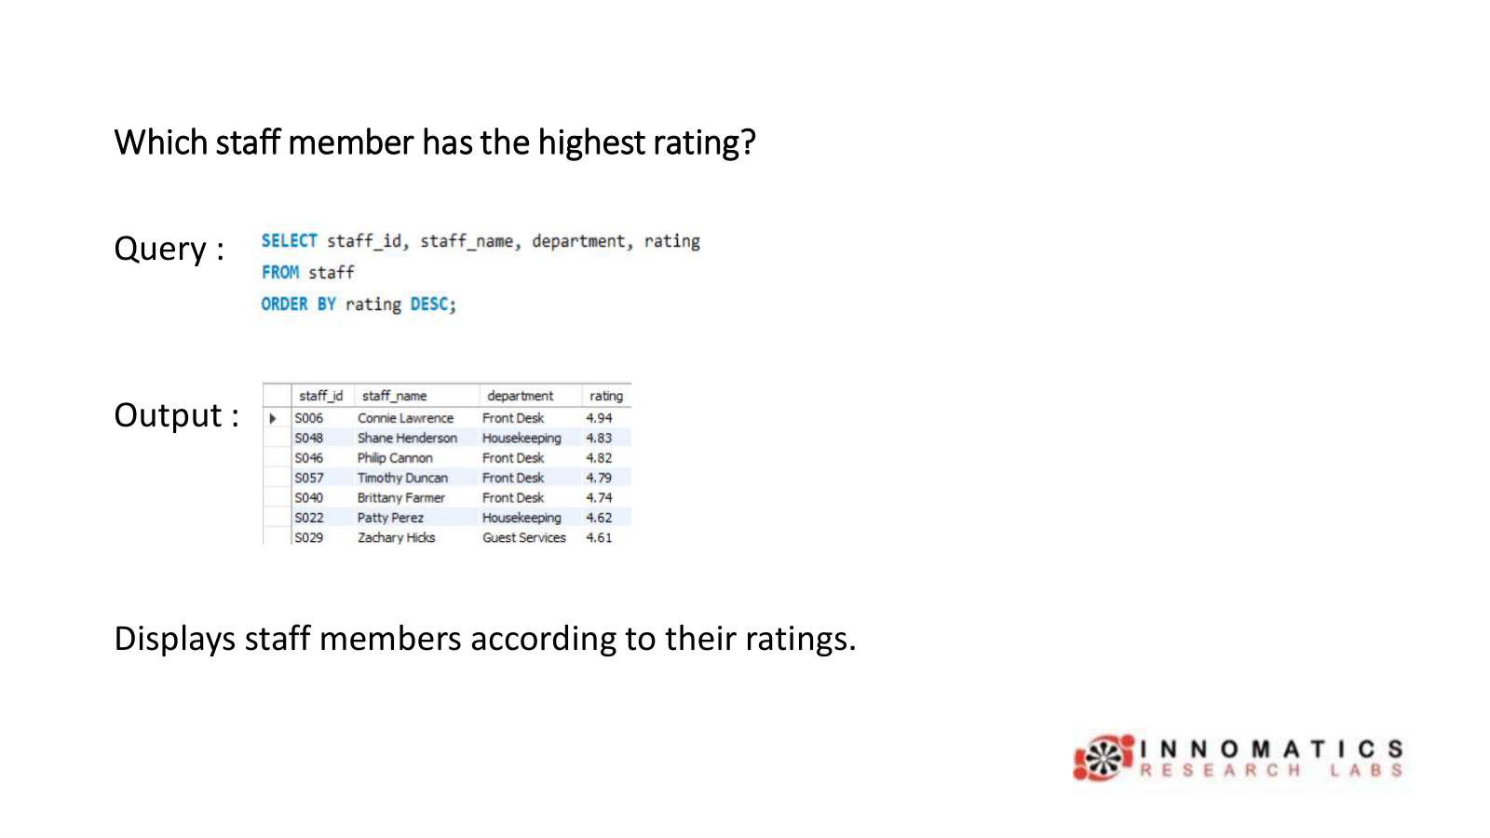

Slide 19
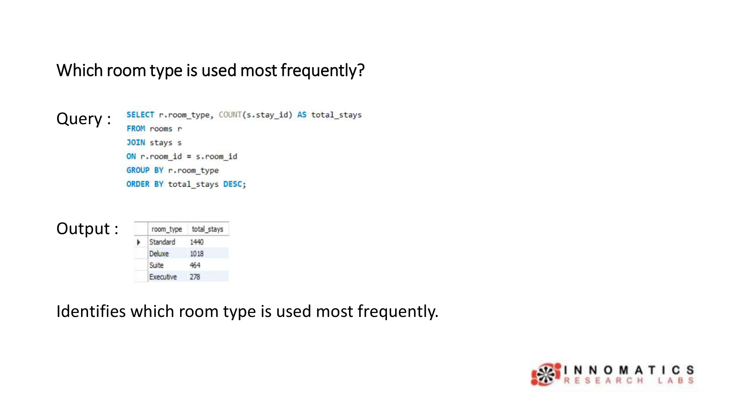

Slide 20
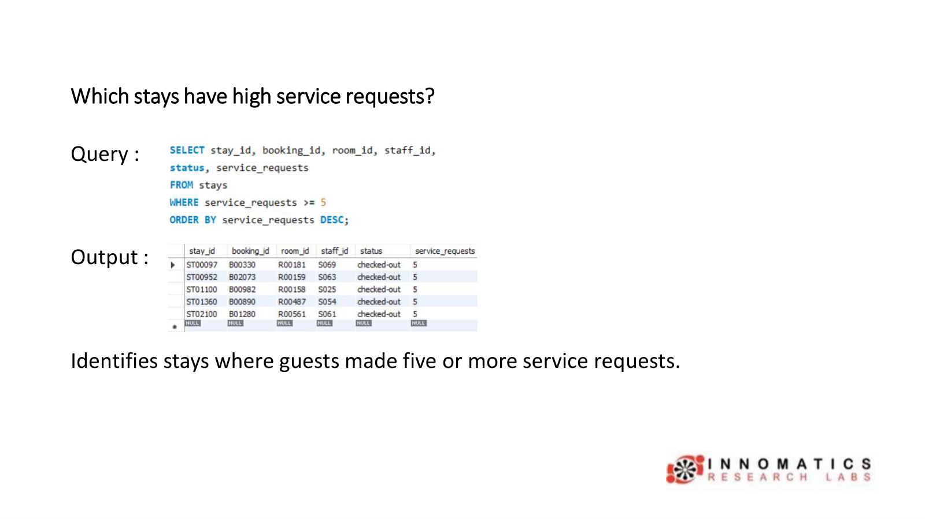

Slide 21
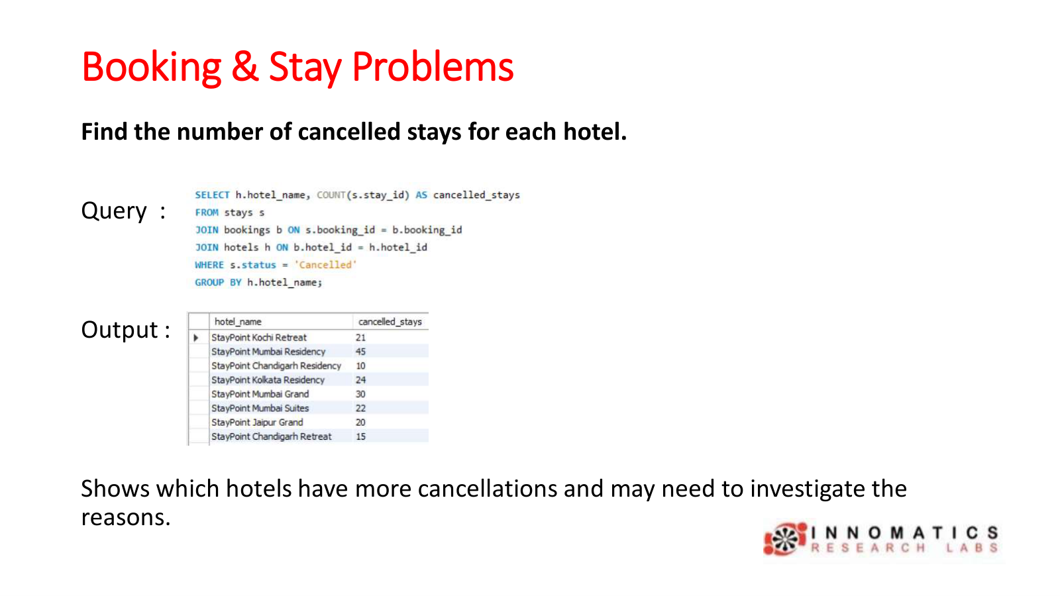

Slide 22
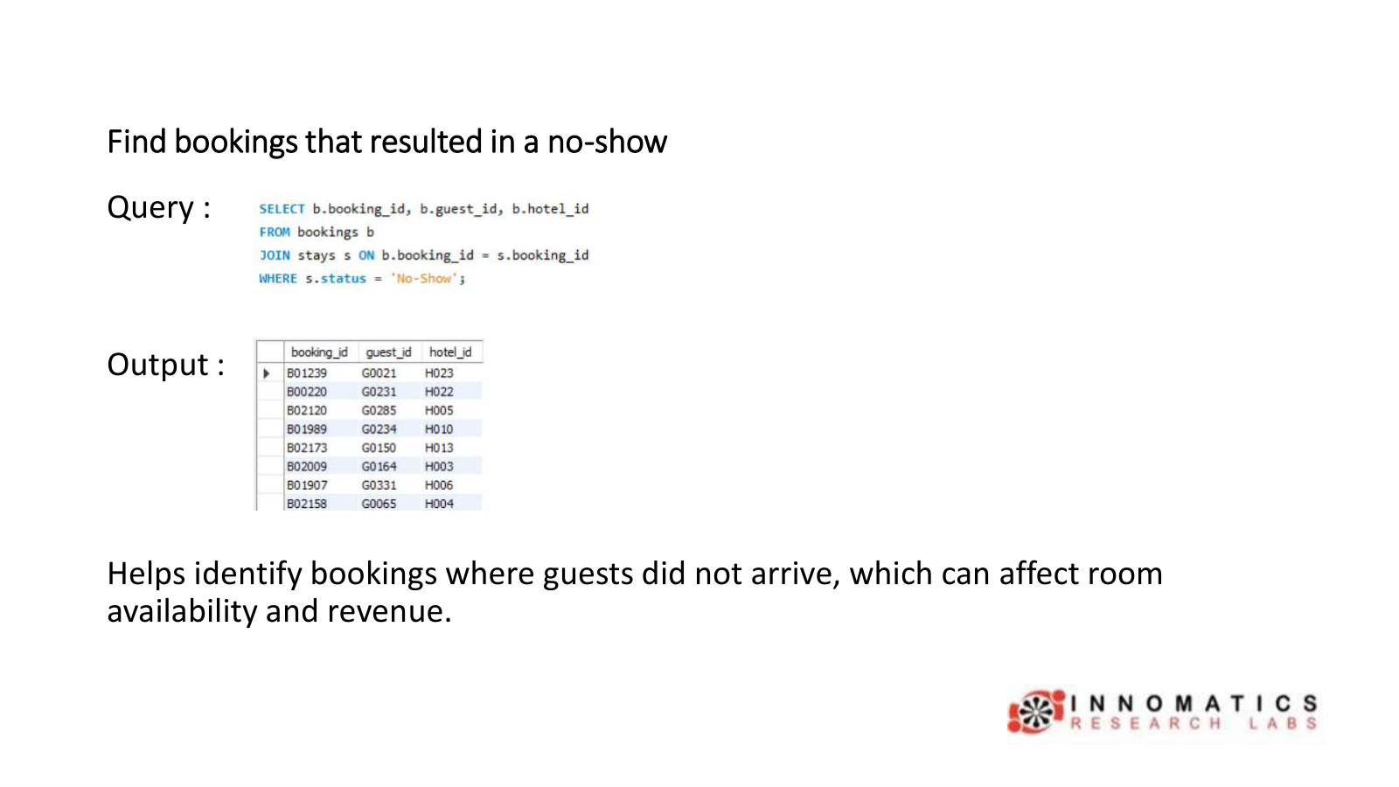

Slide 23
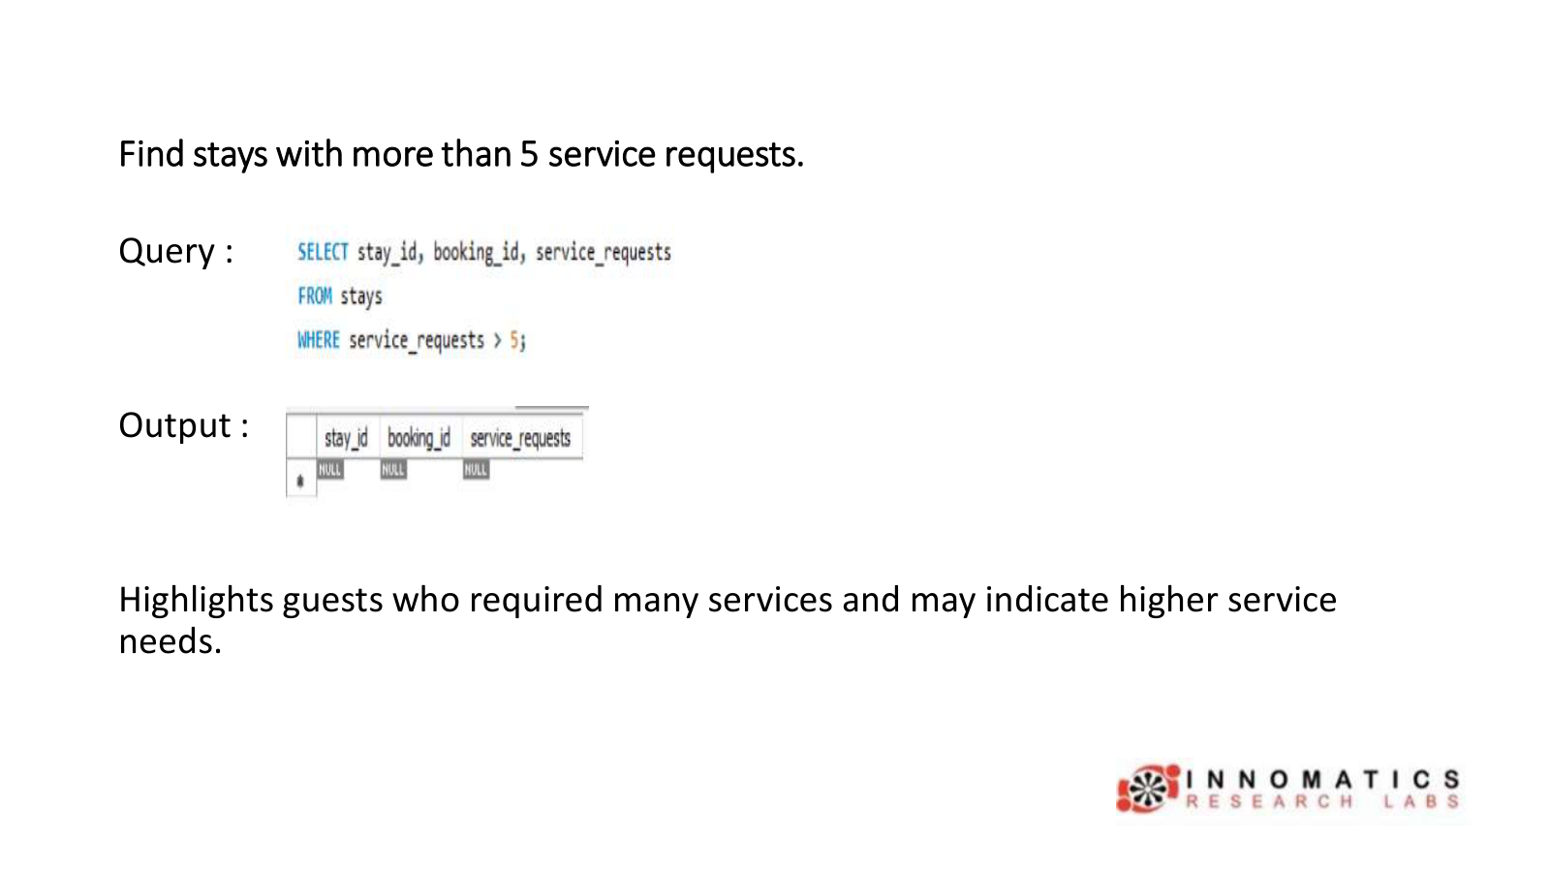

Slide 24
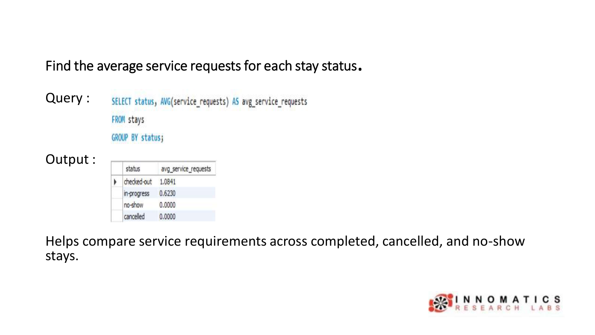

Slide 25
Key Insights
• Booking levels are different across hotels, with some receiving more reservations.
• Guest booking patterns vary between different customer types.
• Cancellations and no-shows can reduce occupancy and revenue.
• Some room types are more popular and frequently used.
• Staff workload varies based on stays and service requests.
• Overall, the analysis helps identify booking trends, guest preferences, room demand, and areas for improving hotel operations.

Slide 26
Recommendations
• Make more rooms available in hotels and room categories that have higher demand.
• Send regular booking reminders and follow simple cancellation rules to avoid lost reservations.
• Create attractive offers for different guest groups, especially individual and corporate customers.
• Assign staff according to the number of guests, bookings, and services required.
• Give priority to booking channels that perform well and improve the channels with fewer bookings.

Slide 27
Challenges Faced
• Understanding the connections between guests, hotels, rooms, bookings, stays, and staff.
• Creating SQL queries using joins, filters, grouping, and other functions.
• Keeping the data correct while checking bookings, stays, and cancellations.
• Finding useful information and patterns from the database.
• Comparing bookings, revenue, room usage, guest activity, and staff performance.

Slide 28
Conclusion
• Analyzed hotel reservation data using SQL to understand booking and stay activities.
• Identified key trends in bookings, cancellations, occupancy, and room availability
• Used SQL queries with different tables to get useful information from the database.
• Observed booking patterns and changes in overall hotel operations.
• The analysis can help improve room planning, staff work, and reservation management.
• Overall, the project demonstrates how SQL can be used for effective Hostel
Reservation Operations Analytics.

Slide 29

Thank You

